Slide 1

Capstone Project
Travel Management System
Jalaj Jha

Slide 2



Project Overview
Objective: Develop a Travel Management System for administrators to manage trips, cabs, bookings, payments, and feedbacks.
Technologies Used:
Backend: Spring Boot, Spring Data JPA
Frontend: Angular, Bootstrap
Database: MySQL
www.collaberadigital.com

Slide 3

Business Requirements
Target Users: System Administrators
Core Operations:
Login & Authentication
CRUD Operations for trips, cabs, bookings, payments, and feedback
Search, View, and Delete Details
Admin Registration

Slide 4

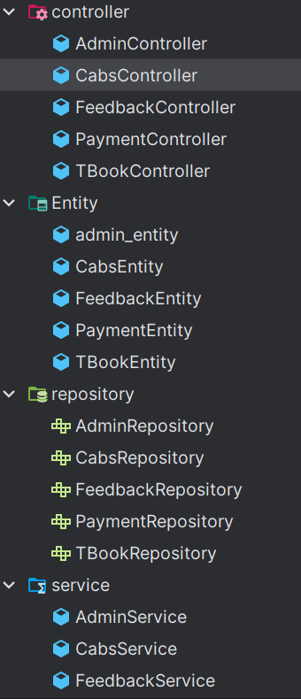
Backend Implementation
Frameworks and Tools: Spring Boot, MySQL
Key Features:
Auto ID generation
Flawless Connectivity to Front-end
Managing Primary and Foreign Key
Testing Tools: Postman

Slide 5

Frontend Implementation
Framework: Angular
UI Design:
Design with Bootstrap and CSS
Routing and Route Guards
Features:
Forms with validation
User-friendly
Screen Navigation: Describe key screens (Login, Dashboard, CRUD forms, etc.)

Slide 6

Database Design
Database: MySQL
Key Tables:
Cabs
Bookings
Payments
Feedback
Admins
Constraints:
Primary Keys, Foreign Keys

Slide 7
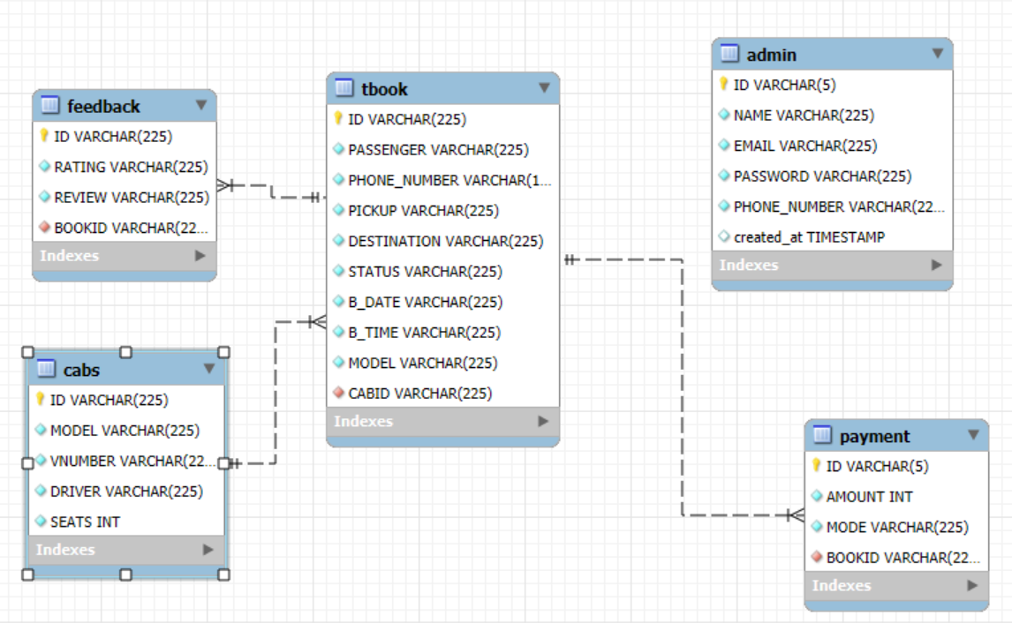
ER DIAGRAM

Slide 8
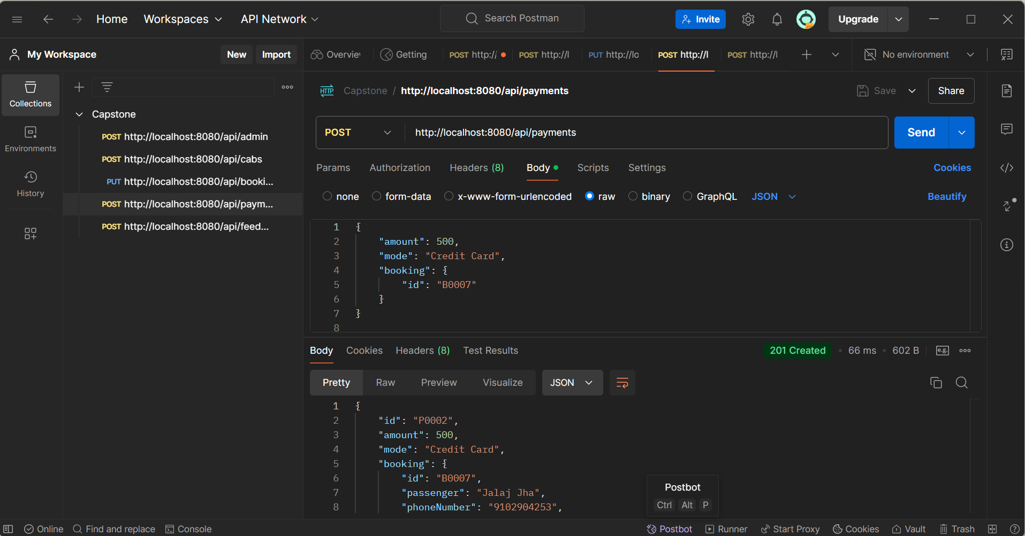
Testing through Postman-

Slide 9
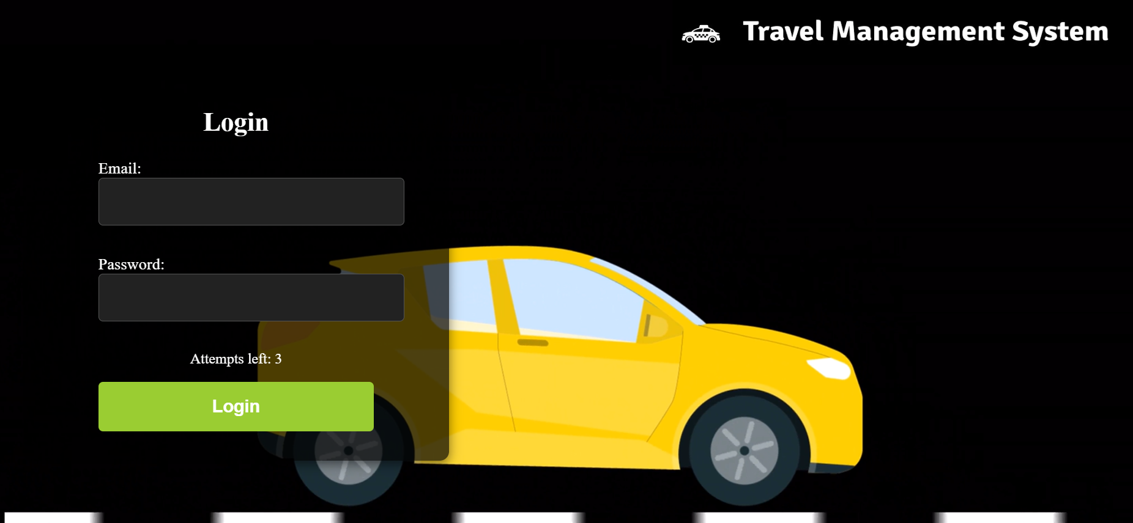
Login Page-

Slide 10
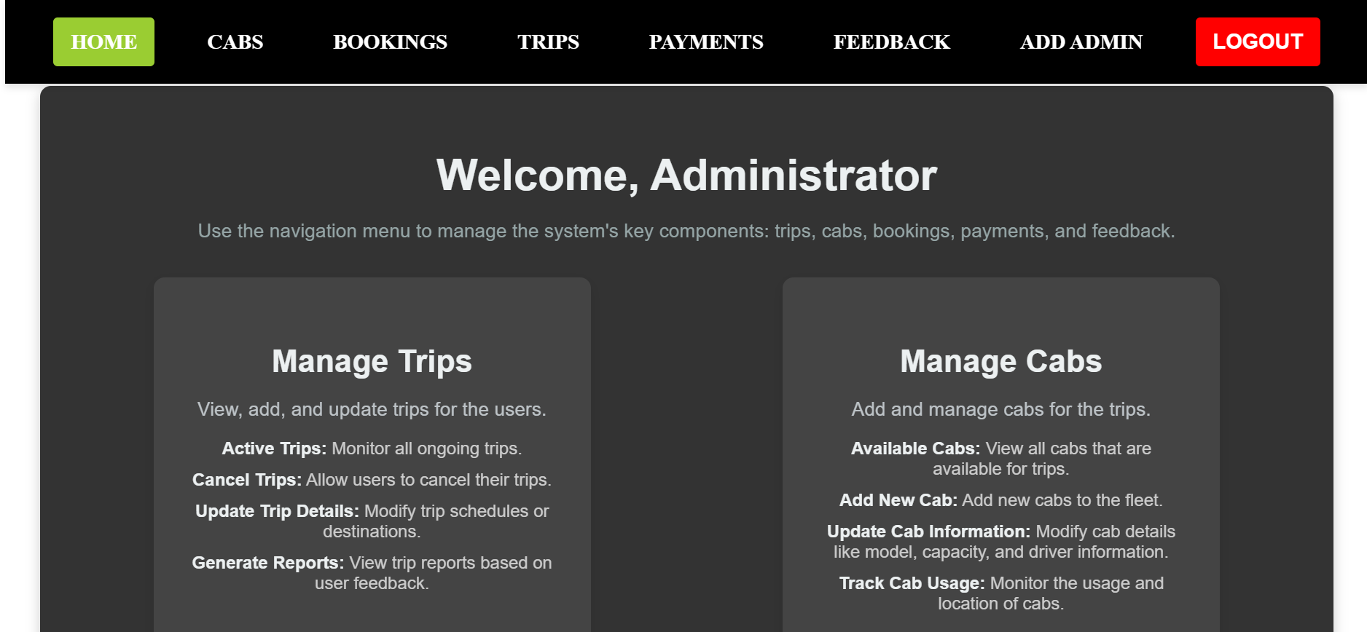
Home Page containing what all operations admin can do:-

Slide 11
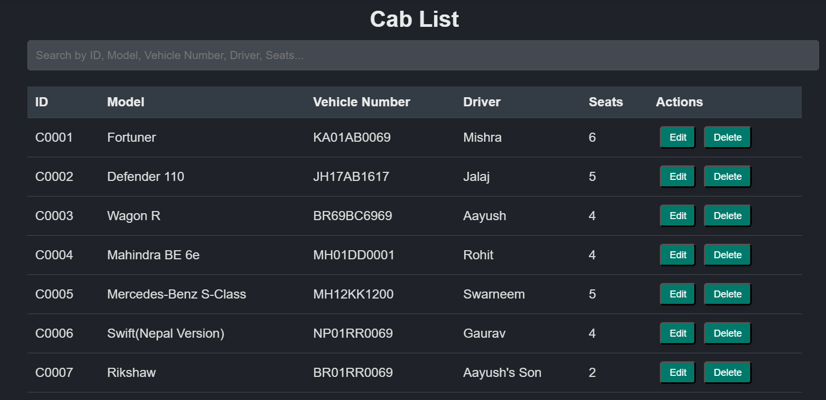
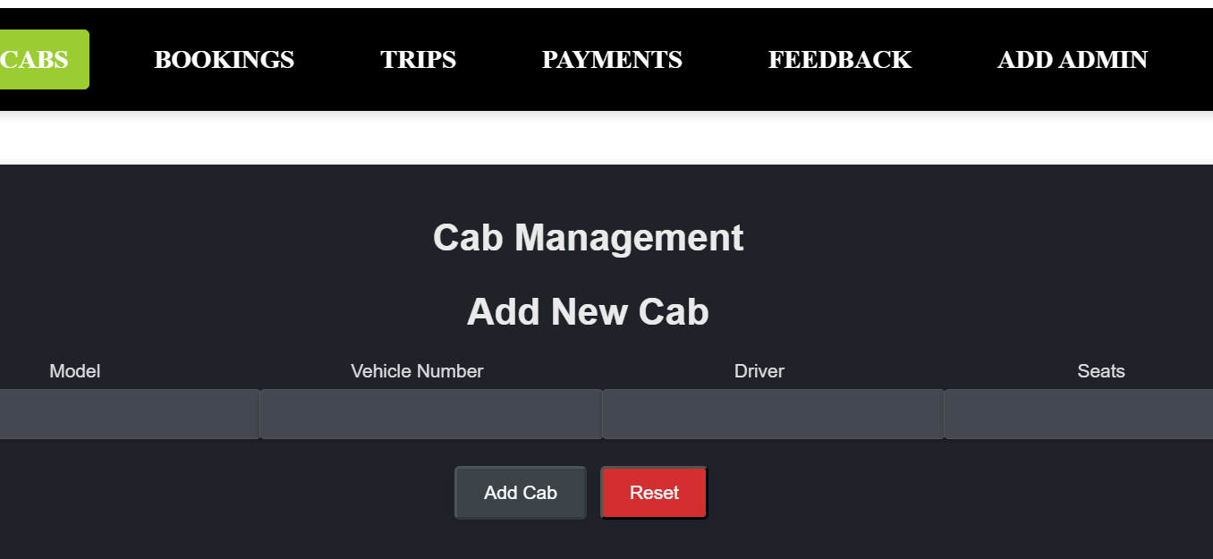
Cabs page having list of all cabs with all CRUD operations

Slide 12
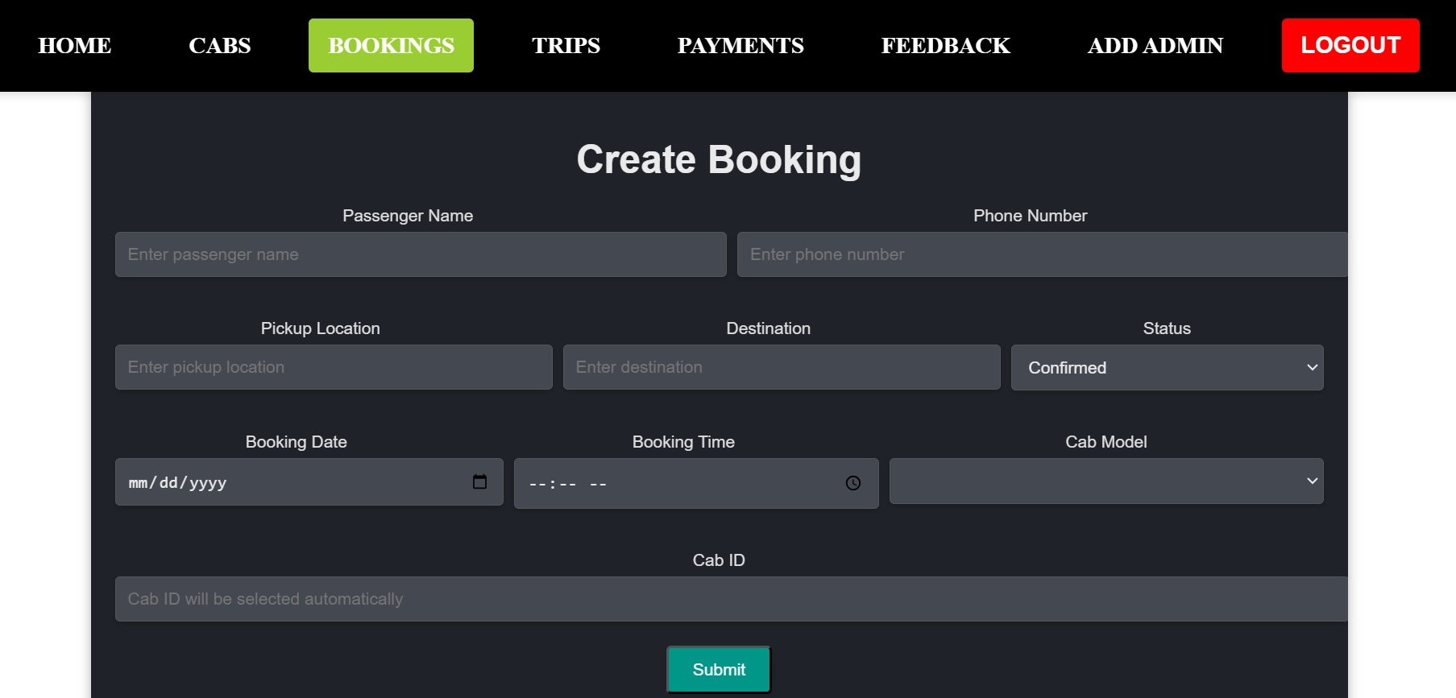
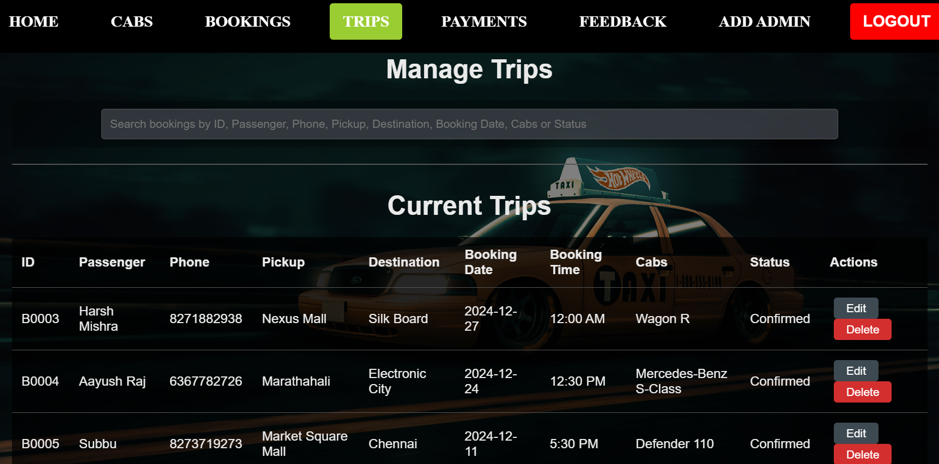
Booking Page that stores the data and display on the trip page

Slide 13
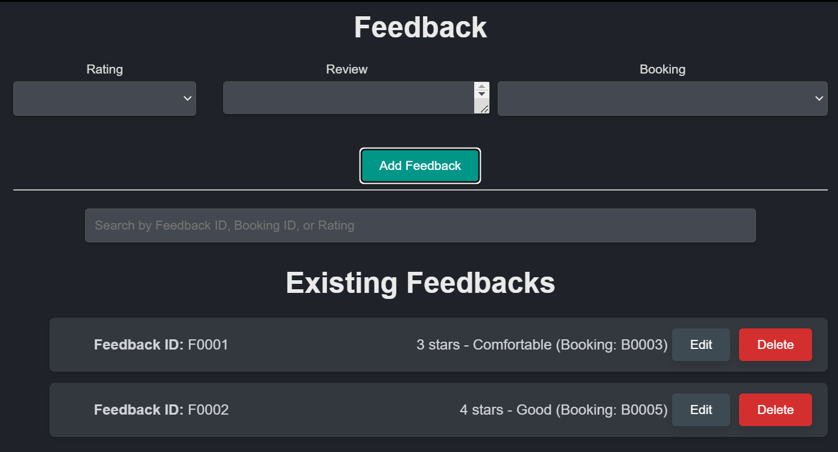
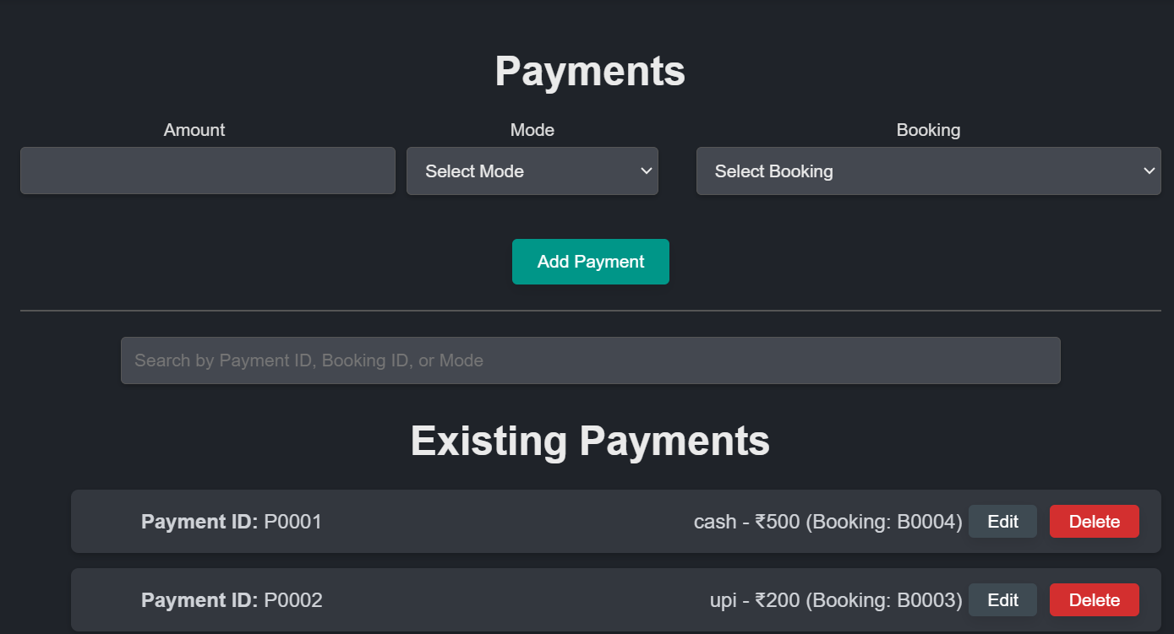
Payment and Feedback that uses foreign key to fetch bookings details from trips

Slide 14
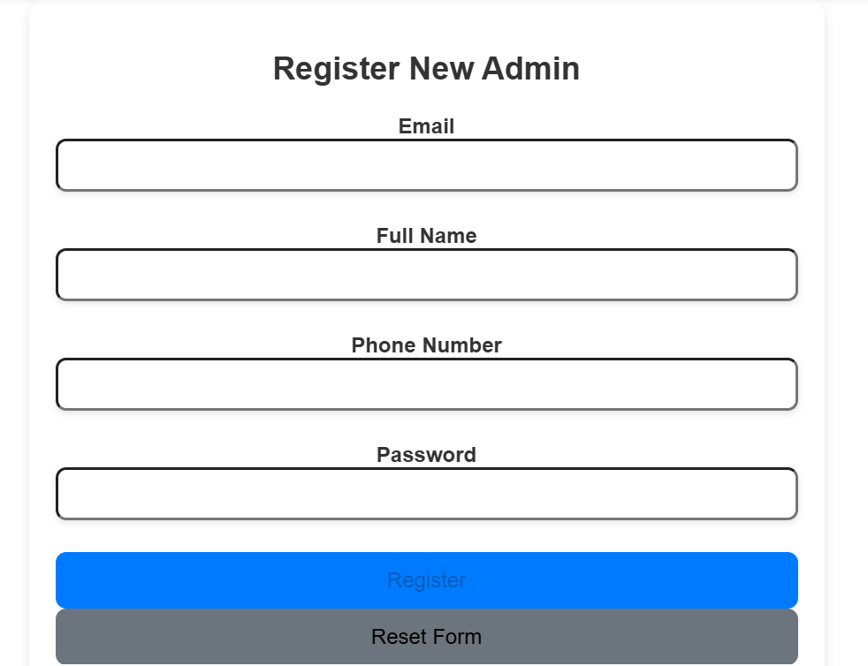
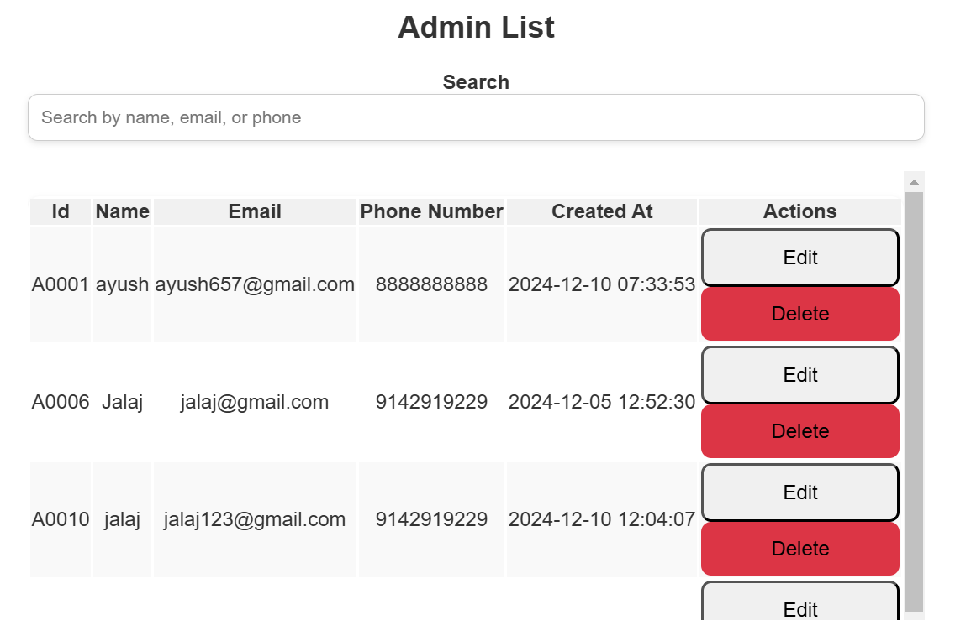
Add Admin

Slide 15
Best parts of the project-
Foreign Key is working properly.
Duplicate payment will not be processed for a same booking id.
Duplicate feedback will not be processed for a same booking id.
When a cab is added it gets available in the booking page also.
All the validations are present like of email, phone no, etc.

Slide 16
Challenges faced-
Auto ID Generation: Ensuring unique ID generation in a valid format.
Timestamp Error: Addressing issues with incorrect or inconsistent timestamps.
ID Reset Issue: Preventing the auto-generated ID from resetting to the initial value (e.g., "B0001") upon restarting the backend.
Video Auto-Play Issue: Disabling or controlling the auto-play of videos on the login page.
Layout Problems: Resolving various design and layout inconsistencies across pages.
Page Navigation: Properly linking each page to another using appropriate service integrations.

Slide 17
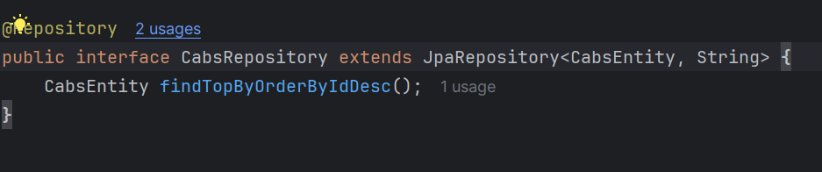
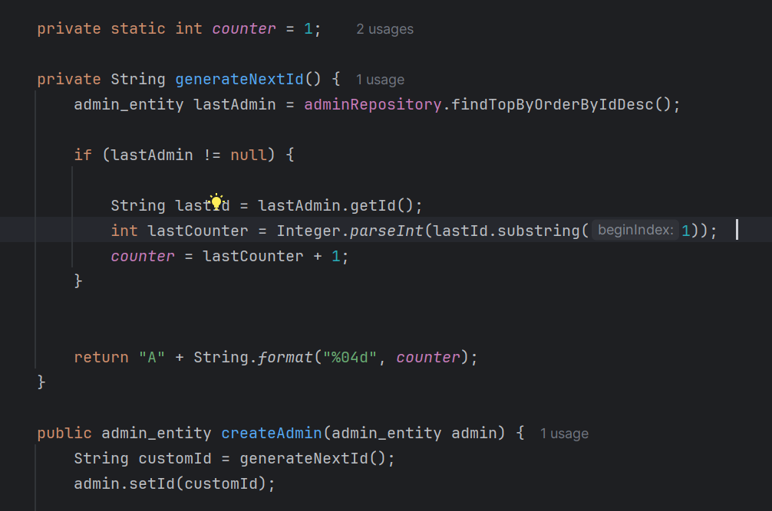
Solutions-
Retrieved the ID with the highest value.
Extracted the numeric portion from the ID.
Incremented the numeric part by 1 to generate the next sequential ID.
Implemented a query in the repository using findTopByOrderByIdDesc() to fetch the latest ID.

Slide 18
Conclusion and Future Scope
Conclusion:
Successfully developed and demonstrated the project.
Implemented key functionalities with proper validation and best practices.
Future Scope:
Looking forward for a more responsive design.
Using of proper naming conventions.
Also want to know the deployment part.

Slide 19

Thank You

